Slide 1
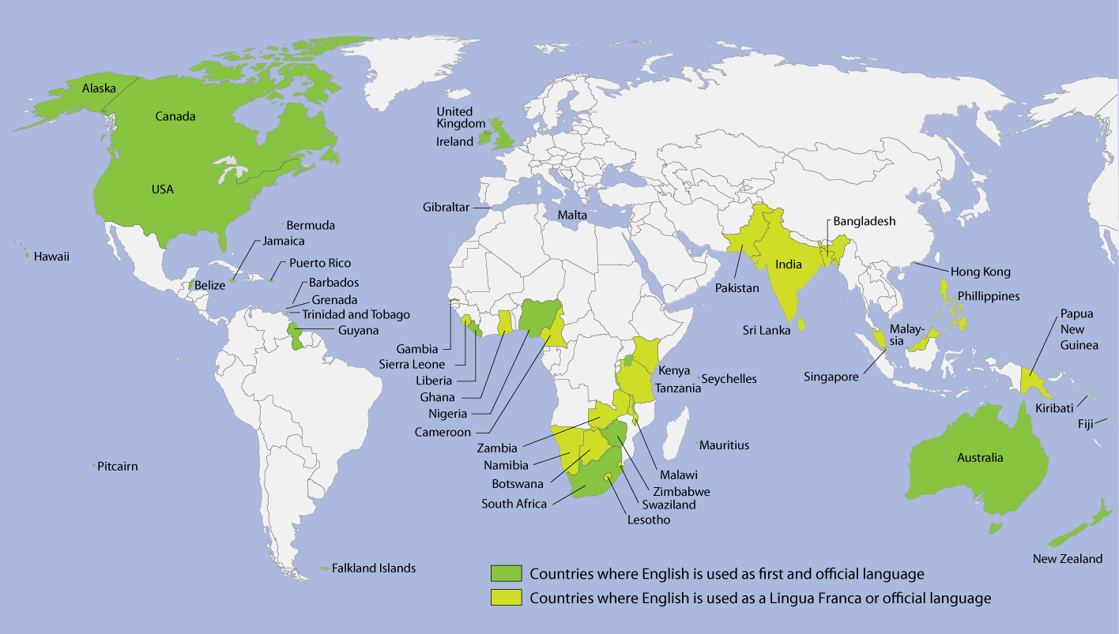
Global Language

Slide 2
Vocabulary
Put the letters in the right order to make a word:
1. t, i, r, y, i, c, d, o, n, a
2. c, u, b, l, o, v, r, a, y
3. o, r, w, o, r, b
4. e, v, e, p, o, l, d
5. g, e, n, u, o, t
6. r, o, p, n, o, n, u, c, e
7. t, h, o, m, e, r

Slide 3
Keys
1. dictionary
2. vocabulary
3. borrow
4. develop
5. tongue
6. pronounce
7. mother

Slide 4
Complete the sentences with the correct form of the new words
1. Her _ _ _ _ _ _ _ _ _ _ _ _ is probable Russian.
2. English has _ _ _ _ _ _ _ _ a lot of words from other European languages.
3. His _ _ _ _ _ _ _ _ _ _ is not very large, he is only a small boy.
4. Words _ _ _ _ _ _ _ new meanings, don’t they?
5. How do you _ _ _ _ _ _ _ _ _ this word? I don’t know it.
6. When you open this well-known _ _ _ _ _ _ _ _ _ _,
you can learn a lot about words.

Slide 5
Match the word combinations and their definitions
1. An official language | a) A means for solving world problems caused by misunderstanding
2. A foreign language | b) The language spoken at the present time
3. A mother tongue a native language | c) The language of communication in a country which is also used in government, schools, etc.
4. A modern language | d) The first language you learnt as a child
5. An international language | e) A non- native language taught at school, university, etc.

Slide 6
Watch the video and answer the questions
1. In what countries do people use English as their mother tongue?
2. In what countries do people use English as the second important language?
3. Who is English important for?
4. Why did English become very important?
5. Do you know Russian words which came to English?
Sable – poetic black or very dark
Mammoth – extremely large, a mammoth task
Tsar, tzar, czar –a male ruler of Russia before 1917
Intelligentsia – the people in a society who are most highly educated and who are most interested in new ideas and developments, especially in art, literature, or politics
Sputnik - satellite
Cosmonaut – astronaut
Steppes – an area of land without trees, especially an area in Russia, parts of Asia, and south east of Europe

Slide 7
England and America are two countries separated by the same language. Oscar Wilde

Slide 8
Write American English words for these British nouns
British English | American English
trousers
lorry
chips
car park
chemist’s

Slide 9
Homework
Ex.10, p. 80-81. Get ready to write Dictation 2.
Ex.7, p. 83. Make a project on the topic “British and American English”.

Slide 10
Reflexing
Now I know …/
I don’t know …
Now I can …/ I can’t …

Slide 11
Reflexing
1.Now I can speak about how English developed
2. … I can speak about the importance of English nowadays
Now I know in what countries people use English as their mother tongue
3…in what countries they use English as the second language
4… where in the world people are interested in learning English, use it as a foreign language
5. Now I can write a paragraph about why the English and Americans sometimes can’t understand each other
6…why it is important to know English

